Slide 1

Exploratory Data Analysis
Hate Speech detection using Transformers
Group Name: OMAJO
Name:Omar Hamdan
Email: o.hamdaan10@gmail.com
Country: Jordan
College: Princess Sumaya University For Technology
Specialization: NLP
16/04/2024

Slide 2
Agenda
Problem Statement
EDA - Dataset Overview
EDA - Statistical Summary
EDA - Label Distribution & Data Integrity
EDA - Tweet Length Distribution
EDA - Word Frequency Analysis
Recommendations

Slide 3
Problem Statement
In today's digital landscape, the rise of hate speech on social media threatens individual well-being and societal peace. With over 60% of users encountering hate speech, impacting 30% of them significantly, there's an urgent need for intervention. Our project aims to employ advanced machine learning to develop a model that detects hate speech on Twitter, helping platforms moderate content effectively. Designed to adapt to the evolving digital communication patterns, our model seeks to balance content moderation with free speech, envisioning social media as safe spaces for respectful and open dialogue.

Slide 4
EDA - Dataset Overview
Dataset Overview
We embarked on an initial exploratory data analysis to understand our dataset structure, types of data contained, and any immediate observations that could inform our subsequent analysis and modeling efforts. Here are our findings:
Dataset Composition: Our dataset includes tweets categorized into hate speech (1) and non-hate speech (0). Each tweet is uniquely identified by an id and is presented in both original (tweet) and pre-processed (cleaned_tweet) forms.
Initial Peek:
The dataset comprises four main columns: id, label, tweet, and cleaned_tweet.
id: Unique identifier for each tweet.
label: Indicates hate speech (1) or not (0).
tweet: Original tweet text.
cleaned_tweet: Pre-processed tweet text.
Dataset Shape:
Contains 31,962 rows and 4 columns.
Data Types and Completeness:
No missing values detected across all columns.
Columns include two integers (id, label) and two strings (tweet, cleaned_tweet).

Slide 5
EDA - Statistical Summary
Offers a numerical overview of the dataset, particularly useful for the label distribution.
 | ID | LABEL
Count | 31962 | 31962
Mean | 15981.50 | 0.070146
Std | 9226.778988 | 0.255397
min | 1.0000000 | 0.00000000
25% | 7991.2500 | 0.0000
50% | 15981.500000 | 0.0000
75% | 23971.75000 | 0.000000
max | 31962 | 1.0000

Slide 6
EDA - Label Distribution & Data Integrity Check
Label Distribution : Essential for understanding the balance of classes within our dataset. The dataset is significantly skewed towards non-hate speech tweets.
Data Integrity Check
After initial exploration, we conducted a thorough check for data integrity issues, specifically focusing on missing values and duplicate entries.
Missing Values & Duplicate Entries: We checked each column for missing & duplicate values and found none across the dataset.
id : 0
label : 0
tweet : 0
cleaned_tweet : 0
This preliminary analysis has set the stage for deeper dives into data preprocessing, feature engineering, and
ultimately, the development and evaluation of models for hate speech detection.
Label | Label Counts
0 | 29720
1 | 2242

Slide 7
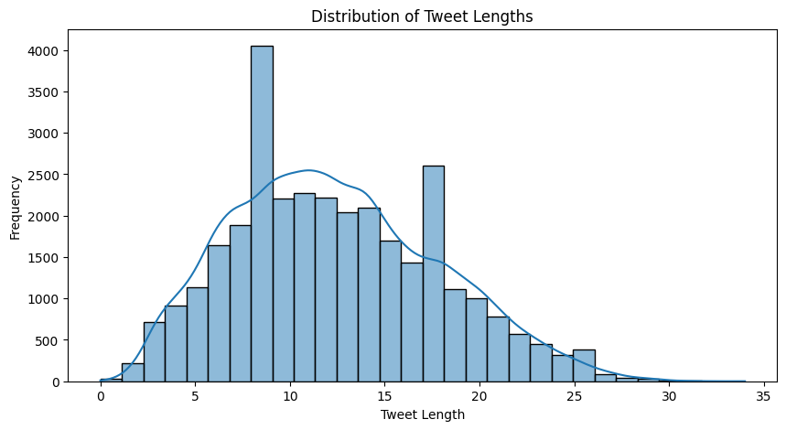
EDA - Tweet Length Disrtibution
Tweet Length Distribution Analysis
We calculated the length of each cleaned tweet to explore the distribution of tweet lengths within our dataset. The length of a tweet is defined as the number of words it contains after preprocessing.
The histogram indicates the majority of tweets are between 10 to 20 words long. A kernel density estimate (KDE) is also plotted to show the distribution trend. This information is crucial as it might impact the choice of tokenization and padding strategies when preparing the data for input into our NLP model.

Slide 8
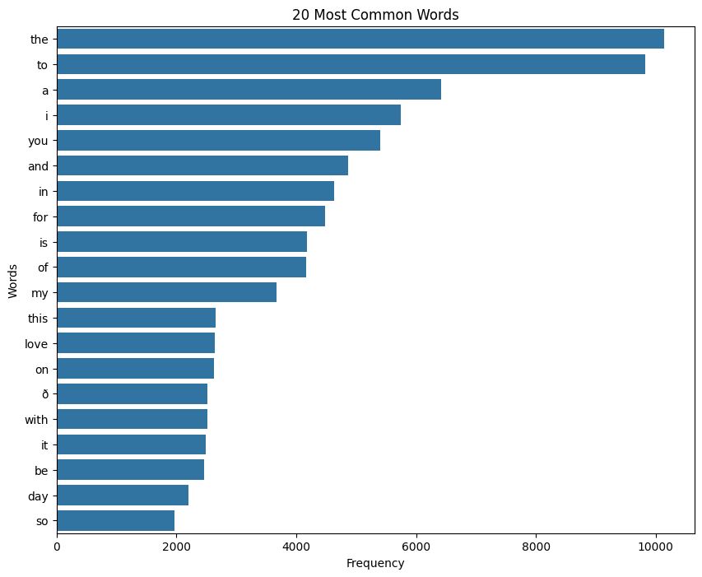
EDA - Word Frequency Analysis
Word Frequency Analysis
We consolidated all the cleaned tweets to form a collective text and then identified the most common words. This analysis helps in understanding the general vocabulary and discourse present in the tweets.
The following bar chart visualizes the 20 most common words found in our dataset, providing insights into the recurrent themes and terms used in the tweets.
From the chart, we can observe that some of the most frequent words are common English words, which are typically known as 'stop words' in NLP. These words often require removal before further processing since they may not contribute meaningful information for analysis or modeling tasks.

Slide 9
Technical Considerations and Recommendations
Model Recommendations:
Given the textual nature of the data, Transformer-based models are recommended due to their state-of-the-art performance on NLP tasks.
BERT (Bidirectional Encoder Representations from Transformers): A pre-trained model that can be fine-tuned on our specific dataset to understand the context of each tweet better.
RoBERTa (A Robustly Optimized BERT Pretraining Approach): An optimized version of BERT that has been trained on a larger dataset and longer, improving performance on text classification tasks.
DistilBERT: A smaller, faster, cheaper, and lighter version of BERT that retains most of its performance, suitable for environments with computational constraints.
Handling Class Imbalance:
Resampling Techniques: Oversampling the minority class (hate speech tweets) or undersampling the majority class to balance the dataset.
Class Weight Adjustment: Applying different weights to the classes during model training to make the model pay more attention to the minority class.
Synthetic Data Generation: Using techniques like SMOTE to generate synthetic examples of the minority class in feature space.
Cost-Sensitive Training: Modify the loss function to impose a higher cost for misclassifying the minority class.
Preprocessing & Tokenization:
Subword tokenization to handle the informality and creative text of tweets, which is common in social media text.
Removal of 'stop words' as identified in our word frequency analysis, to reduce noise and focus on meaningful text.

Slide 10
Thank You

